Slide 1
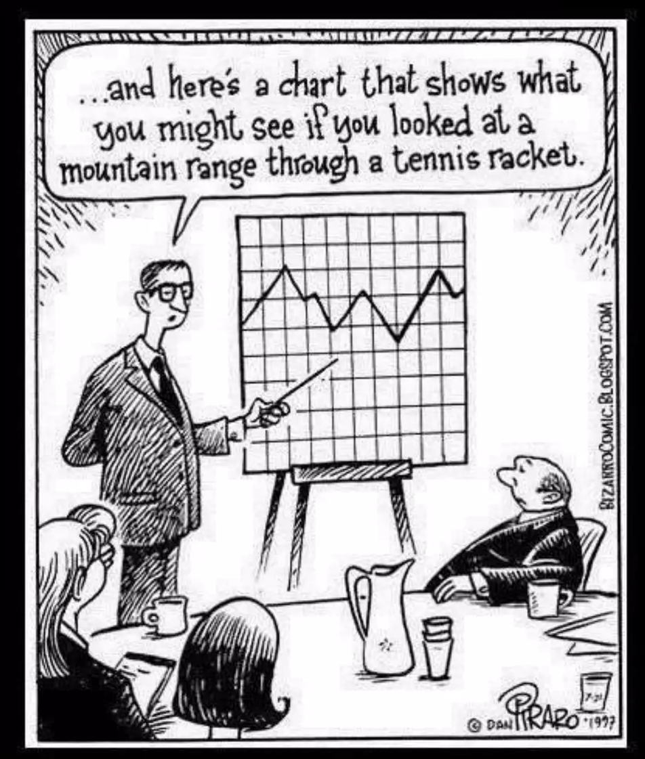
Production Possibility Curve (PPC)
Chathuranga Adhikari
B.com (Sp)(Hons), M.com

Slide 2

Learning Outcomes
Understand what a production possibility curve is
Assumptions of the production possibility curve
Define opportunity cost and apply it to daily situations
Understand how to graph and analyze a PPF.
Explain how preferences influence our production decisions.

Slide 3
From Scarcity to production possibility curve
In economics, it’s the primary study of how the scarce resources of the economy should be used to satisfy unlimited human wants. If so, those resources should be utilizing more efficient way.
In order to gain the maximum outcome from the available resources, society must use its resources in a way that achieves both the targets of full employment and full production.
Here, full employment means utilizing all the resources that can be used for current production. This doesn’t affect sustainability since it uses the specific terms of current resources instead of existing resources
Full production means every production factor used in the production process must contribute to its maximum to meet the physical needs of the customers.
However, this does not always happened, under employment situation also happen.

Slide 4
From Scarcity to production possibility curve
At any given time, due to the scarcity of the resources available in the economic system, even an economy geared towards full employment and full production can’t produce unlimited products or services.
Therefore, the economy must decide which goods and services to produce and which not to produce using limited resources. This is fundamentally a question of choice.
So, the economy has developed a very simple model to analyze choice and the consequences of choice. This can be introduced as the production possibilities model.
This model can be presented in the form of a table or a graph.

Slide 5
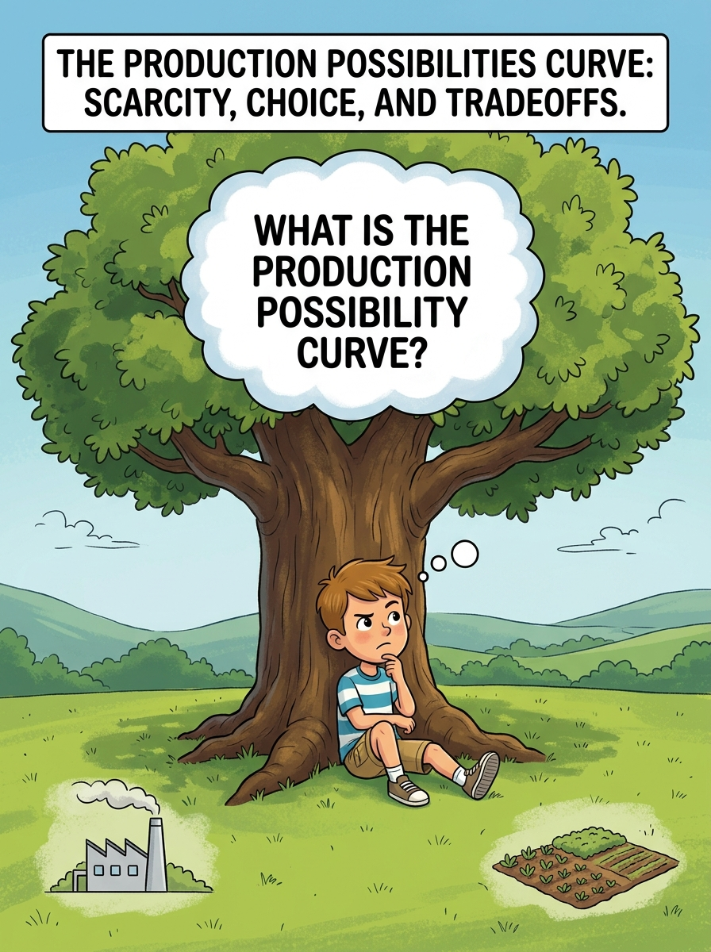
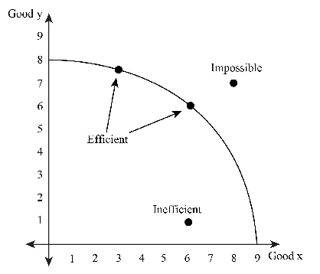
Production Possibility Curve (PPC)
A production possibilities Curve (PPC) is a graphical representation of all possible maximum combinations of total output that could be produced.

Slide 6
Assumptions of Production Possibility Curve
There are 04 assumptions that need to be considered when developing the production possibility curve
  01. Resources are fixed over the period under consideration.
  02. Resources are used to achieve full employment and productive efficiency.
  03. Technology also remained unchanged over the period under consideration.
  04. Producing only two products.

Slide 7
Example 01
Under the assumption that all resources are used at maximum efficiency at a given level of technology, the quantities of units of goods X and Y that can be produced are as shown in the table below;
Point | Smart Phones | Laptops
A | 0 | 15
B | 1 | 14
C | 2 | 12
D | 3 | 9
E | 4 | 5
F | 5 | 0

Slide 8
Example (Cont.)
Point A indicates that when all the resources are directed to producing only Laptops, as a result, none of the smartphones can be produced.
Conversely, point F shows that when all the resources are directed to producing only smartphones, as a result, none of the laptops can be produced.
Thus, if all resources are allocated to producing both smartphones and laptops, rather than producing only one of them, there are many alternative combinations of goods that can be produced, represented by points B, C, D, and E.
Further, the table shows that when resources are used to increase the number of smartphones, as a result, it will reduce the number of laptops produced. Similarly, when more resources are used to produce more laptops, on the other hand, it decreases the number of smart phone are producing
Based on this, we can conclude that, in a given situation, if the economy has achieved full employment and production efficiency, it is possible to produce more of one good only by sacrificing the production of another good.

Slide 9
Production Possibility Curve
X
The frontier shows the limit of what can be produced – all possible combinations when all resources are fully utilized.
Y

Slide 10
Production Possibility Curve
Usually, a point is chosen where both items are being produced
Because Production may occur anywhere on or within the frontier.
It may NOT occur beyond the frontier– there are not enough resources to do so.

Slide 11
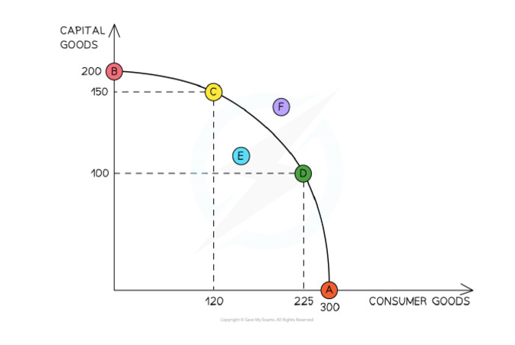
Example 02
Point B
All the resources are being used to produce capital goods
Point A
All the resources are being use to produce consumer goods
Point C & D
Both goods are produced and production is efficient.
Point E
Point E (any point inside the frontier) - production is inefficient
Point F
Unattainable point

Slide 12
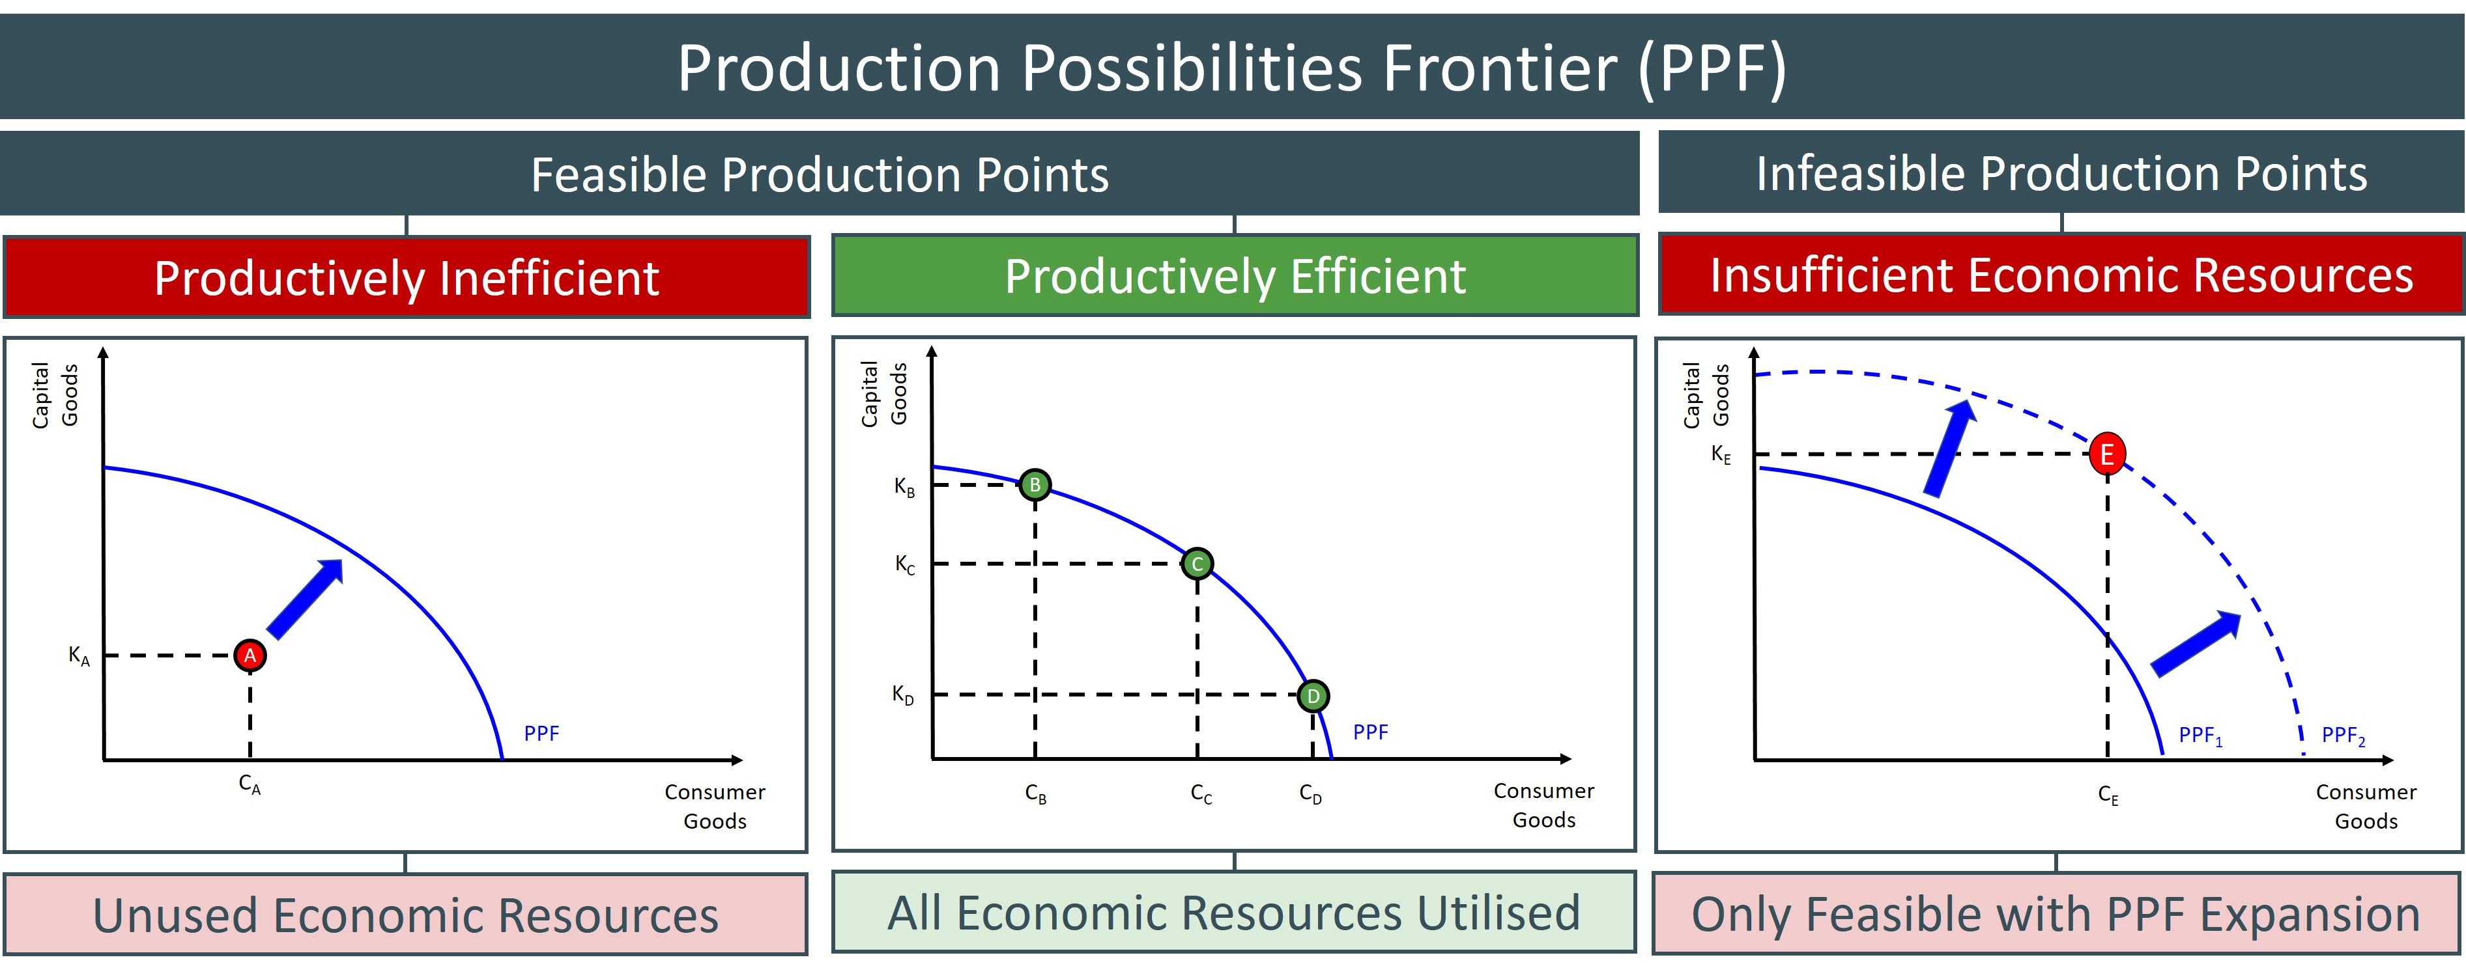
Efficient Production
Efficient production means that all resources are being fully employed to produce the most goods and services possible.
Points inside the curve represent underemployment or unemployment
Therefore, it is impossible to produce more of one item without producing less of the other.

Slide 13
Inefficient Production
Inefficient production means not all resources are being fully employed – it is still possible to increase the production of both goods.
This could occur during a recession or depression, or in a developing country.

Slide 14
Unattainable Points
Any point outside the PP curve is impossible. More of both goods cannot be produced with the current resources

Slide 15
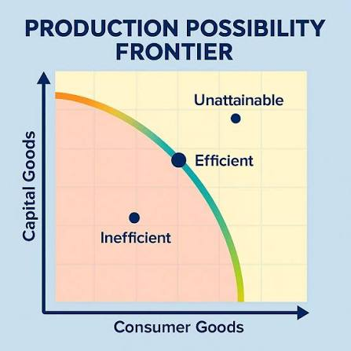

Slide 16
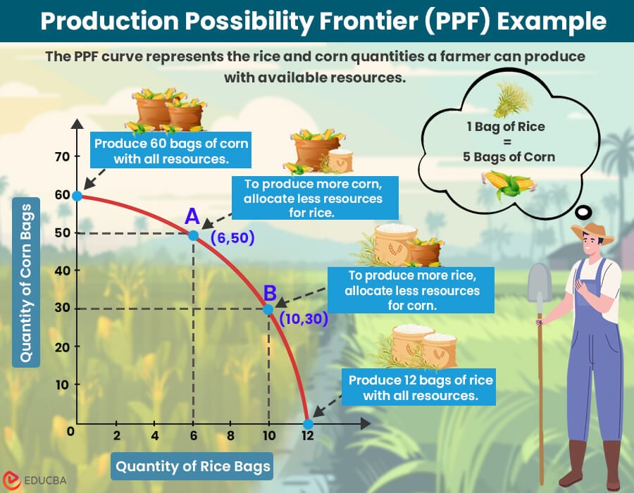

Slide 17
The PPF can be used to show tradeoffs/choices.
Any two or more points on the frontier represent tradeoffs.
X
Y

Slide 18
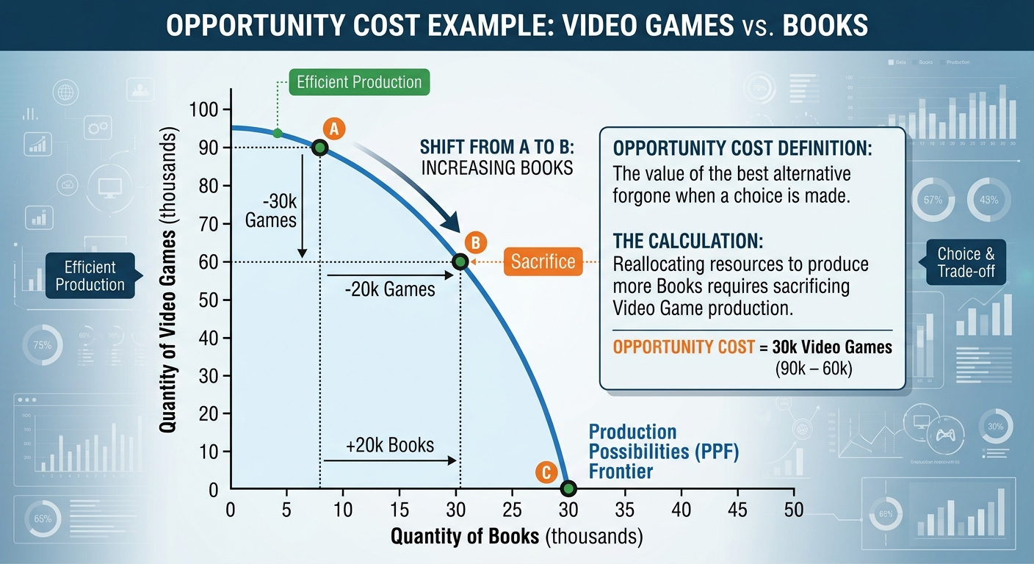
The PPF can be used to show the opportunity cost of choosing one alternative over the other.

Slide 19
Production “Possibilities” Table
A
B
C
D
E
f
Bikes
14
12
9
5
0
0
Computers
0
2
4
6
8
10
Each point represents a specific combination of goods that can be produced given full employment of resources.
NOW GRAPH IT: Put bikes on y-axis and computers on x-axis

Slide 20
Production Possibilities
How does the PPC graphically demonstrates scarcity, trade-offs, opportunity costs, and efficiency?
14
12
10
8
6
4
2
0
Impossible/Unattainable
(given current resources)
A
B
G
C
Bikes
Efficient
D
Inefficient/ Unemployment
E
0 2 4 6 8 10
Computers

Slide 21

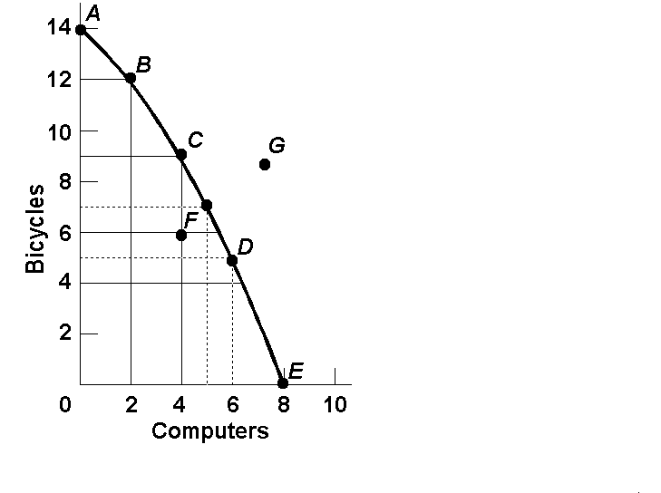
Opportunity Cost
Example:
  1. The opportunity cost of moving from a to b is…
2 Bikes
  2.The opportunity cost of moving from b to d is…
7 Bikes
  3.The opportunity cost of moving from d to b is…
4 Computer
  4.The opportunity cost of moving from f to c is…
0 Computers
  5. What can you say about point G?
Unattainable

Slide 22
Example 03
Points | X Product | Y Product
A | 0 | 1000
B | 100 | 900
C | 200 | 700
D | 300 | 400
E | 400 | 0
Draw a production possibility curve using the given information

Slide 23
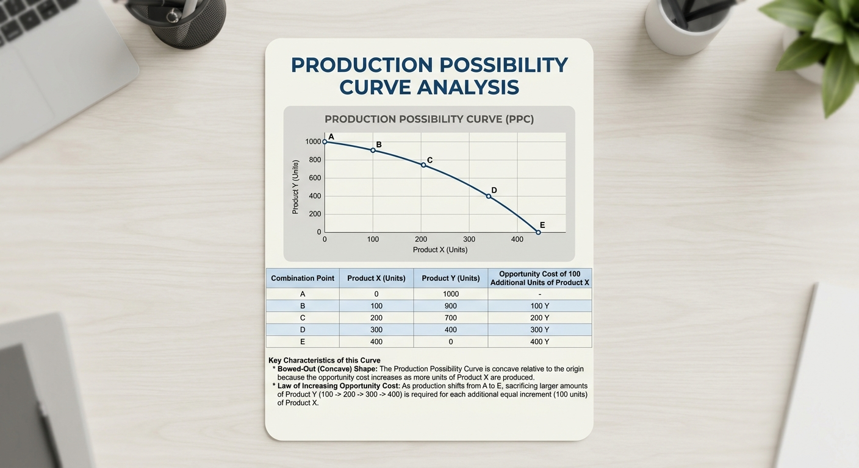

Slide 24
The Production Possibilities Curve and Efficiency

Slide 25
Two types of Efficiency
Productive Efficiency
Products are being produced in the least costly way.
This is any point ON the Production Possibilities Curve
Allocative Efficiency
The products being produced are the ones most desired by society.
This optimal point on the PPC depends on the desires of society.

Slide 26
Shifting the Production Possibilities Curve
4 Key Assumptions Revisited
Only two goods can be produced
Full employment of resources
Fixed Resources (4 Factors)
Fixed Technology
What if there is a change?
3 Shifters of the PPC
  1. Change in resource quantity or quality
  2. Change in Technology
  3. Change in Trade

Slide 27
Production Possibilities
What happens if there is an increase in population?
Robots
Pizzas

Slide 28
Production Possibilities
What happens if there is an increase in population?
Robots
Pizzas
28

Slide 29
Production Possibilities
What if there is a technology improvement in pizza ovens
Robots
Pizzas
29

Slide 30
Production Possibilities
What if there is a technology improvement in pizza ovens
Robots
Pizzas
30

Slide 31
PPC Practice
Draw a PPC showing changes for each of the following. Also, explain why the change is taking place.
Pizza and Robots (3)
1. New robot-making technology
2. Decrease in the demand for pizza
3. Mad cow disease kills 85% of cows
Consumer goods and Capital Goods (4)
4. Destruction of power plants leads to severe electricity shortage
5. Faster computer hardware
6. Many workers are unemployed
7. Significant increases in education

Slide 32
Question #1
New robot making technology
Q
A shift only for Robots
Robots
Q
Pizzas
32

Slide 33
Question #2
Decrease in the demand for pizza
Q
The curve doesn’t shift!
A change in demand doesn’t shift the curve
Robots
Q
Pizzas
33

Slide 34
Question #3
Mad cow disease kills 85% of cows
Q
A shift inward only for Pizza
Robots
Q
Pizzas
34

Slide 35
Question #4
Reduction in Electricity
Q
Decrease in resources decrease production possibilities for both
Capital Goods (tools)
Q
Consumer Goods (Butter)
35

Slide 36
Question #5
Faster computer hardware
Q
Quality of a resource improves shifting the curve outward
Capital Goods (tools)
Q
Consumer Goods (Butter)
36

Slide 37
Question #6
Many workers unemployed
Q
The curve doesn’t shift!
Unemployment is just a point inside the curve
Capital Goods (tools)
Q
Consumer Goods (Butter)
37

Slide 38
Question #7
Significant increases in education
Q
The quality of labor is improved. Curve shifts outward.
Capital Goods (tools)
Q
Consumer Goods (Butter)
38

Slide 39
Importance of the Production Possibility Curve
As productive resources of the economy are always limited, PPC helps in deciding which commodities are most beneficial to society.
Helps in deciding what amount of goods are to be produced amongst different alternatives available.

Slide 40
Limitations of the Production Possibility Curve
There is a choice between only two commodities.
It talks about production capabilities but doesn’t consider the want of goods.
It doesn’t consider the satisfaction generated with an accepted outcome.

Slide 41
Thank you

